Slide 1
Chapter 7: Deadlocks
Narzu Tarannum Lecturer BRACU

Slide 2
Covered in chapter 7
The Deadlock Problem
System Model
Deadlock Characterization
Methods for Handling Deadlocks
Deadlock Prevention
Deadlock Avoidance
Deadlock Detection
Recovery from Deadlock

Slide 3
Chapter Objectives
To develop a description of deadlocks, which prevent sets of concurrent processes from completing their tasks.
To present a number of different methods for preventing or avoiding deadlocks in a computer system.

Slide 4
Bridge Crossing Example
Deadlock cause (a situation or opposing parties) to come to a point where no progress can be made because of fundamental disagreement.
Each section of a bridge can be viewed as a resource.
Traffic moves only in one direction on the Bridge.
Deadlock occurs!
If deadlock occurs, it can be resolved if one car backs up.
Several cars may have to be backed up.
Deadlock is a situation where a set of processes are blocked because each process is holding a resource and waiting for another resource acquired by some other process.

Slide 5
The Deadlock Problem
A process requests resources; if the resources are not available at that time, the process enters a wait state. It may happen that waiting process will never gain change state, because the resources they have requested are held by other waiting processes. This situation is called a deadlock.
Example
System has 2 Resources: R1, R2.
P1 and P2 each hold one resource and each needs another one.
Allocated
R1
Requested
P1→R1
P2→R2
Need R2
Need R1
P1
P2
Requested
R2
Allocated

Slide 6
System Model
A system consist of a finite number of resources to be distributed among a number of competing processes.
Resource types R₁, R₂, . . ., R_{m}
Process are P₁, P₂, . . ., P_{n}
Resources are partitioned into several types
Physical resource for example, CPU cycles, memory space, I/O devices .
Logical resources for example, semaphores, mutex locks, and ﬁles.
Each resource type consisting of some number of identical instance.
Each resource type R_{i} has W_{i} instances.

Slide 7
System Model
Under the normal mode of operation, a process may utilize a resource in only the following sequence:
Request: The process requests the resource.
Use: The process can operate on the resource
Release: The process releases the resource.
A process must request a resource before using it and must release the resource after using it.

Slide 8
Necessary Conditions for Deadlock
Deadlock can arise if four conditions hold simultaneously in a system:
Mutual exclusion
Hold and wait
No preemption
Circular wait
If one of them is not present in a system, no deadlock will arise

Slide 9

Necessary Conditions
R1
1. Mutual exclusion: At least one resource must be held in a non-sharable mode; only one process at a time can use a resource.
P1
P2
R1
P1
P2
R1
P1
P2

Slide 10
Necessary Conditions
2. Hold and wait: a process holding at least one resource is waiting to acquire additional resources held by other processes.
R1
P1
P2
R2

Slide 11

Necessary Conditions
3. No preemption: a resource can be released only voluntarily by the process holding it, after that process has completed its task.

Slide 12
Necessary Conditions
4. Circular wait: There must be a circular chain of two or more processes each of which is waiting for a resource held by the next member of the chain.
R1
P1
P2
R2

Slide 13
Resource-Allocation Graph
A set of vertices V and a set of edges E.
V is partitioned into two types:
P = {P₁, P₂, …, P_{n}}, the set consisting of all the processes in the system. R = {R₁, R₂, …, R_{m}}, the set consisting of all resource types in the system.
request edge – directed edge P₁ → R_{j}
assignment edge – directed edge R_{j} → P_{i}
G → ( V, E)
Process
Request edge P_{i} → R_{j}
Resource
Allocation edge R_{j} → P_{i}

Slide 14
Resource-Allocation Graph (Cont.)
Process
Resource Type with 4 instances
P_{i} requests instance of R_{j}
P_{i} is holding an instance of R_{j}
P_{i}
R_{j}
P_{i}
R_{j}

Slide 15
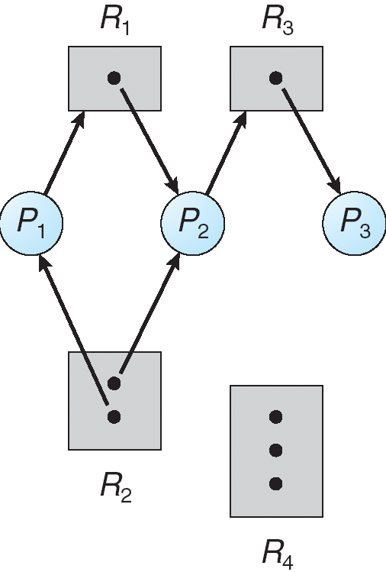
Example of a Resource Allocation Graph
P ={P1, P2, P3}
R ={R1, R2, R3, R4}
E ={P1 → R1, P2 → R3, R1 → P2, R2 → P2, R2 → P1, R3 → P3}

Slide 16
Basic Facts
If graph contains no cycles ⇒ no deadlock.
If graph contains a cycle ⇒ a deadlock may occur
if only one instance per resource type, then deadlock.
if several instances per resource type, possibility of deadlock.

Slide 17
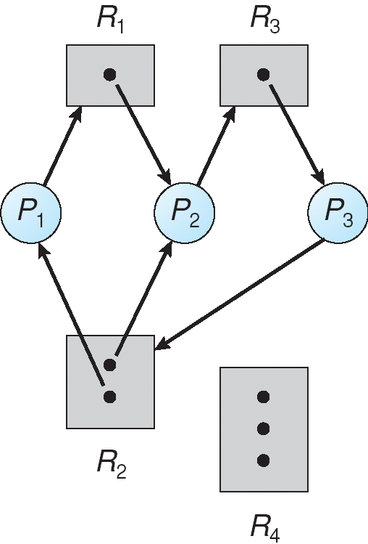

Resource Allocation Graph With A Deadlock
In the figure At this point, two minimal cycles exist in the system:
P1 → R1 → P2 → R3 → P3 → R2 → P1
P2 → R3 → P3 → R2 → P2

Slide 18
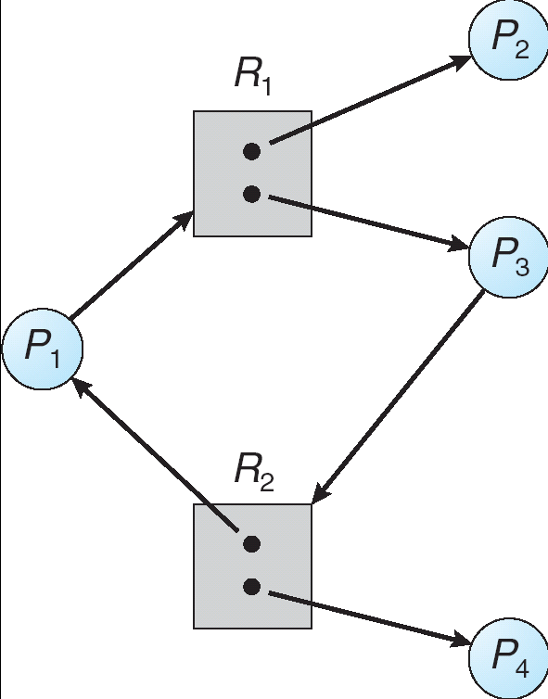
Resource Allocation Graph With A Cycle But No Deadlock

Slide 19
Methods for Handling Deadlocks
Ensure that the system will never enter a deadlock state (Deadlock prevention).
In deadlock avoidance, the request for any resource will be granted if the resulting state of the system doesn't cause deadlock in the system. In order to avoid deadlocks, the process must tell OS, the maximum number of resources a process can request to complete its execution.(Deadlock avoidance).
Allow the system to enter a deadlock state and then recover (Deadlock detection and recovery).
Ignore the problem and pretend that deadlocks never occur in the system; used by most operating systems, including UNIX. (Ignorance)

Slide 20
Methods for Handling Deadlocks
Deadlock prevention
Deadlock avoidance
Deadlock detection and recovery
Ignorance

Slide 21
Deadlock Prevention
Eliminate one of the four conditions.
1.Mutual Exclusion – not required for sharable resources; must hold for non-sharable resources.
R1
R2
P1
P2

Slide 22
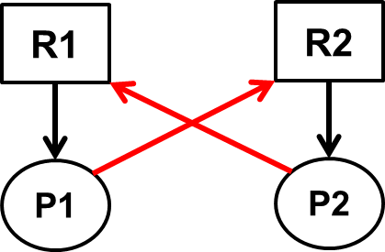
Deadlock Prevention (Cont.)
2.Hold and Wait – must guarantee that whenever a process requests a resource, it does not hold any other resources.
First Protocol or conservative approach: A process is allowed to start execution if and only if it has acquired all the resources.
Second Protocol or do not hold approach: A process will acquire only desired resources but before making any fresh request, it must release all the resources that it currently hold.
Third Protocol or wait-time out approach: We place a maximum time bound up to which a process can wait for resources, after which the must release all the holding resources.
R1, R2, … R4, R5, ………R10

Slide 23
Deadlock Prevention (Cont.)
3.No Preemption –
If a process that is holding some resources requests another resource that cannot be immediately allocated to it, then all resources currently being held are released.
Preempted resources are added to the list of resources for which the process is waiting.
Process will be restarted only when it can regain its old resources, as well as the new ones that it is requesting.

Slide 24

Deadlock Prevention (Cont.)
4.Circular Wait – impose a total ordering of all resource types, and require that each process requests resources in an increasing order of enumeration.
R1
R2
P1 | P2
R1 | R2
R2 | R1
P1 | P2
R1 | R1
R2 | R2
P1
P2
P1
R2
P2
R1

Slide 25
Deadlock Prevention (Cont.)
4.Circular Wait – impose a total ordering of all resource types, and require that each process requests resources in an increasing order of enumeration. Let R = R1, R2, ……., Rm are the resources.
-Circular wait can be eliminated by just giving the natural number of every resource. So, we can define the function F: R → N
F(Tape drives) = 2
P1(2,4)
F(Disk drives) = 3
P1(3,4,5)
F(Scanners) = 4
F(Printers) = 5

Slide 26
Methods for Handling Deadlocks
Deadlock prevention
Deadlock avoidance
Deadlock detection and recovery
Ignorance

Slide 27
Deadlock Avoidance
Banker’s Algorithm requires the information of each process that declare the maximum number of resources of each type that it may need.
The deadlock-avoidance algorithm dynamically examines the resource-allocation state to ensure that there can never be a circular-wait condition.
Resource-allocation state is defined by the number of available and allocated resources, and the maximum demands of the processes.
P

Slide 28
Safe-Unsafe State
When a process requests an available resource, system must decide if immediate allocation leaves the system in a safe state.
A state is said to be safe, if there is some scheduling order in which every process can run to completion that means system is in safe state if there exists a safe sequence of all processes.
An unsafe state does not have to lead to a deadlock; it could lead to a deadlock.
ENSURE SYSTEM NEVER REACHES AN UNSAFE STATE

Slide 29
Example of a Safe-unsafe state
Let there are 3 processes (A, B, C) where total number of resources are 10. Every process has to declare maximum number of resource they need in advance. In present scenario system allocated 3 units of resources to A where maximum requirement of A is 9 units. In the same way system allocated 2 units to B where maximum requirement of B is 4 and system allocated 2 units to C where maximum requirement of C is 7
 | Has | Max
A | 3 | 9
B | 2 | 4
C | 2 | 7
Free: 3 units
Total: 10 units

Slide 30
Safe state
Allocate 2 units to B
B completes
 | Has | Max
A | 3 | 9
B | 2 | 4
C | 2 | 7
Free: 3 units
 | Has | Max
A | 3 | 9
B | 4 | 4
C | 2 | 7
Free: 1 units
 | Has | Max
A | 3 | 9
B | 0 | -
C | 2 | 7
Free: 5 units
Allocate 6 units to A
C completes
Allocate 5 units to C
 | Has | Max
A | 9 | 9
B | 0 | -
C | 0 | -
Free: 1 unit
 | Has | Max
A | 3 | 9
B | 0 | -
C | 0 | -
Free: 7 units
 | Has | Max
A | 3 | 9
B | 0 | -
C | 7 | 7
Free: 0 units
This is a safe state because there is some scheduling order in which every process executes. Here the order is: B→C→A

Slide 31
Unsafe state
Allocate 2 units to B
B completes
 | Has | Max
A | 4 | 9
B | 2 | 4
C | 2 | 7
Free: 2 units
 | Has | Max
A | 4 | 9
B | 4 | 4
C | 2 | 7
Free: 0 units
 | Has | Max
A | 4 | 9
B | 0 | -
C | 2 | 7
Free: 4 units
5 units to C or A can not be allocated
 | Has | Max
A | ? | 9
B | 0 | -
C | ? | 7
Free: 0 units
This is an unsafe state because there exist no scheduling order in which every process executes.

Slide 32
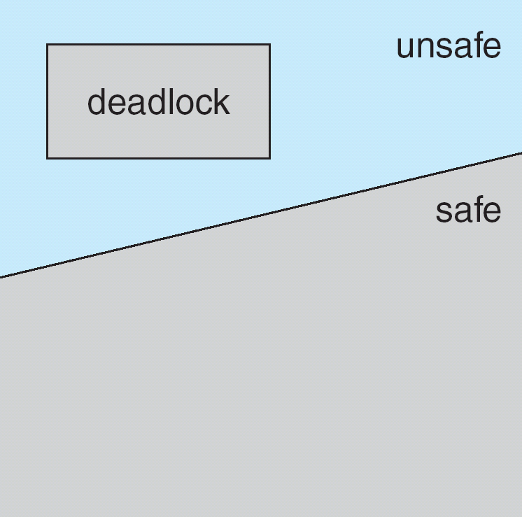
Safe, Unsafe , Deadlock State
If a system is in safe state ⇒ no deadlocks.
If a system is in unsafe state ⇒ possibility of deadlock.
Avoidance ⇒ ensure that a system will never enter an unsafe state.

Slide 33
Banker’s Algorithm
Multiple instances of each resource type.
Each process must a priori claim maximum use.
When a process requests a resource it may have to wait.
When a process gets all its resources it must return them in a finite amount of time.

Slide 34
Data Structures for the Banker’s Algorithm
Let n = number of processes, and m = number of resources types.
Available: Vector of length m. If available [j] = k, there are k instances of resource type R_{j} available.
Max: n x m matrix. If Max [i,j] = k, then process P_{i} may request at most k instances of resource type R_{j}.
Allocation: n x m matrix. If Allocation[i,j] = k then P_{i} is currently allocated k instances of R_{j.}
Need: n x m matrix. If Need[i,j] = k, then P_{i} may need k more instances of R_{j} to complete its task.
Need [i,j] = Max[i,j] – Allocation [i,j].
X<=Y if X=(1,7,3,2) and Y=(0,3,2,1) then X≠Y.

Slide 35
Banker's Safety Algorithm
1. Let Work and Finish be vectors of length m and n, respectively. Initialize:
Work = Available
Finish [i] = false for i=0, 1, …, n-1.
2. Find and i such that both:
(a) Finish [i] = false
(b) Need_{i} ≤ Work
If no such i exists, go to step 4.
3. Work = Work + Allocation_{i} Finish[i] = true go to step 2.
4. If Finish [i] == true for all i, then the system is in a safe state.

Slide 36
Example of Banker’s Algorithm
3 resource types:
A (10 instances), B (5instances), and C (7 instances).
5 processes P₀ through P₄;
Snapshot at time T₀:
Allocation Max Available
A B C A B C A B C
P₀ 0 1 0 7 5 3 3 3 2
P₁ 2 0 0 3 2 2
P₂ 3 0 2 9 0 2
P₃ 2 1 1 2 2 2
P₄ 0 0 2 4 3 3
Need = Max– Allocation
A B C
7 4 3
1 2 2
6 0 0
0 1 1
4 3 1

Slide 37
Example of Banker’s safety Algorithm
1. Let Work and Finish be vectors of length m and n, respectively. Initialize:
Work = Available
Finish [i] = false for i=0,1,…, n-1
2. Find and i such that both:
(a) Finish [i] = false
(b) Need_{i} ≤ Work
If no such i exists, go to step 4.
3. Work = Work + Allocation_{i} Finish[i] = true go to step 2.
4. If Finish [i] == true for all i, then the system is in a safe state.
Process | Allocation | Max | Available | Need
 | A B C | A B C | A B C | A B C
P₀ | 0 1 0 | 7 5 3 | 3 3 2 | 7 4 3
P₁ | 2 0 0 | 3 2 2 |  | 1 2 2
P₂ | 3 0 2 | 9 0 2 |  | 6 0 0
P₃ | 2 1 1 | 2 2 2 |  | 0 1 1
P₄ | 0 0 2 | 4 3 3 |  | 4 3 1
Work = Available = 3 3 2
Finish[0]=Finish[1]=Finish[2]=Finish[3]=Finish[4]=False
Need(P0)>Work → Finish[0]=F → Do Nothing | 7 4 3 ≤ 3 3 2 → F → do nothing
Need(P1)<=Work → Finish[1]=T → Work=Work + AllocationP1 | 1 2 2 ≤ 3 3 2 → T: Work = 3 3 2 + 2 0 0 = 5 3 2
Need(P2)>Work → Finish[2]=F → Do Nothing | 6 0 0 ≤ 5 3 2 → F → do nothing
Need(P3)<=Work → Finish[3]=T → Work=Work + AllocationP3 | 0 1 1 ≤ 5 3 2 → T: Work = 5 3 2 + 2 1 1 = 7 4 3
Need(P4)<=Work → Finish[4]=T → Work=Work + AllocationP4 | 4 3 1 ≤ 7 4 3 → T: Work = 7 4 3 + 0 0 2 = 7 4 5
Need(P0)<=Work → Finish[0]=T → Work=Work + AllocationP0 | 7 4 3 ≤ 7 4 5 → T: Work = 7 4 5 + 0 1 0 = 7 5 5
Need(P2)<=Work → Finish[2]=T → Work=Work + AllocationP2 | 6 0 0 ≤ 7 5 5 → T: Work = 7 5 5 + 3 0 2 = 10 5 7
Found the safe sequence <P1, P3, P4, P0, P2>

Slide 38
Request for resources (1 0 2) for P1 will be granted at this state?

Slide 39
Banker’s Resource-request Algorithm
Request = request vector for process P_{i}. If Request_{i} [j] = k then process P_{i} wants k instances of resource type R_{j.}
P_{i→} Request_{i}
1. If Request_{i} ≤ Need_{i} go to step 2. Otherwise, raise error condition, since process has exceeded its maximum claim.
2. If Request_{i} ≤ Available, go to step 3. Otherwise P_{i} must wait, since resources are not available.
3. Pretend to allocate requested resources to P_{i} by modifying the state as follows:
Available = Available - Request_{i};
Allocation_{i} = Allocation_{i} + Request_{i};
Need_{i} = Need_{i} – Request_{i};
4. Check Bankers safety Algorithm, if this new state is safe
If safe ⇒ the resources are allocated to Pi.
If unsafe ⇒ Pi must wait, and the old resource-allocation state is restored

Slide 40
Example of Banker’s Resource-request Algorithm
Request = request vector for process P_{i}. If Request_{i} [j] = k then process P_{i} wants k instances of resource type R_{j.}
1. If Request_{i} ≤ Need_{i} go to step 2. Otherwise, raise error condition, since process has exceeded its maximum claim.
2. If Request_{i} ≤ Available, go to step 3. Otherwise P_{i} must wait, since resources are not available.
3. Pretend to allocate requested resources to P_{i} by modifying the state as follows:
Available = Available - Request_{i};
Allocation_{i} = Allocation_{i} + Request_{i};
Need_{i} = Need_{i} – Request_{i};
Process | Allocation | Max | Available | Need
 | A B C | A B C | A B C | A B C
P₀ | 0 1 0 | 7 5 3 | 3 3 2 | 7 4 3
P₁ | 2 0 0 | 3 2 2 |  | 1 2 2
P₂ | 3 0 2 | 9 0 2 |  | 6 0 0
P₃ | 2 1 1 | 2 2 2 |  | 0 1 1
P₄ | 0 0 2 | 4 3 3 |  | 4 3 1
Check a new additional request for P₁ (1 0 2) can be granted now?
1. if Request of P1 ≤ Need of P1 | 1 0 2 <= 1 2 2 → T
2. if Request of P1 ≤ Available | 1 0 2 ≤ 3 3 2 → T
3. Available = Available – Request_{i} Allocation_{i} = Allocation_{i} + Request_{i} Need_{i} = Need_{i} – Request_{i} | Available = 3 3 2 – 1 0 2 = 2 3 0 Allocation = 2 0 0 + 1 0 2 = 3 0 2 Need = 1 2 2 – 1 0 2 = 0 2 0

Slide 41
Example of Banker’s Resource-request Algorithm
3. Available = 3 3 2 – 1 0 2 = 2 3 0
Allocation = 2 0 0 + 1 0 2 = 3 0 2
Need = 1 2 2 – 1 0 2 = 0 2 0
Update table after additional request for P₁ (1 0 2)
Process | Allocation | Max | Available | Need
 | A B C | A B C | A B C | A B C
P₀ | 0 1 0 | 7 5 3 | 3 3 2 | 7 4 3
P₁ | 2 0 0 | 3 2 2 |  | 1 2 2
P₂ | 3 0 2 | 9 0 2 |  | 6 0 0
P₃ | 2 1 1 | 2 2 2 |  | 0 1 1
P₄ | 0 0 2 | 4 3 3 |  | 4 3 1
Process | Allocation | Max | Available | Need
 | A B C | A B C | A B C | A B C
P₀ | 0 1 0 | 7 5 3 | 2 3 0 | 7 4 3
P₁ | 3 0 2 | 3 2 2 |  | 0 2 0
P₂ | 3 0 2 | 9 0 2 |  | 6 0 0
P₃ | 2 1 1 | 2 2 2 |  | 0 1 1
P₄ | 0 0 2 | 4 3 3 |  | 4 3 1

Slide 42
Verify with Banker’s safety Algorithm
1. Let Work and Finish be vectors of length m and n, respectively. Initialize:
Work = Available
Finish [i] = false for i=0,1,…, n-1
2. Find and i such that both:
(a) Finish [i] = false
(b) Need_{i} ≤ Work
If no such i exists, go to step 4.
3. Work = Work + Allocation_{i} Finish[i] = true go to step 2.
4. If Finish [i] == true for all i, then the system is in a safe state.
Process | Allocation | Max | Available | Need
 | A B C | A B C | A B C | A B C
P₀ | 0 1 0 | 7 5 3 | 2 3 0 | 7 4 3
P₁ | 3 0 2 | 3 2 2 |  | 0 2 0
P₂ | 3 0 2 | 9 0 2 |  | 6 0 0
P₃ | 2 1 1 | 2 2 2 |  | 0 1 1
P₄ | 0 0 2 | 4 3 3 |  | 4 3 1
Need(P0)>Work → Finish[1]=F → Do Nothing | 7 4 3 ≤ 2 3 0 → F → do nothing
Need(P1)<=Work → Finish[1]=T → Work=Work + Allocation | 0 2 0 ≤ 2 3 0 → T: Work = 2 3 0 + 3 0 2 = 5 3 2
Need(P2)>Work → Finish[2]=F → Do Nothing | 6 0 0 ≤ 5 3 2 → F → do nothing
Need(P3)<=Work → Finish[3]=T → Work=Work + Allocation | 0 1 1 ≤ 5 3 2 → T: Work = 5 3 2 + 2 1 1 = 7 4 3
Need(P4)<=Work → Finish[4]=T → Work=Work + Allocation | 4 3 1 ≤ 7 4 3 → T: Work = 7 4 3 + 0 0 2 = 7 4 5
Need(P0)<=Work → Finish[0]=T → Work=Work + Allocation | 7 4 3 ≤ 7 4 5 → T: Work = 7 4 5 + 0 1 0 = 7 5 5
Need(P2)<=Work → Finish[2]=T → Work=Work + Allocation | 6 0 0 ≤ 7 5 5 → T: Work = 7 5 5 + 3 0 2 = 10 5 7
Since there is a safe sequence <P1, P3, P4, P0, P2> , Additional request P₁ (1 0 2) can be granted

Slide 43
Are following requests get accepted?
Request for (3 3 0) resources for P4
Request for (0 2 0) resources for P0
Process | Allocation | Max | Available | Need
 | A B C | A B C | A B C | A B C
P₀ | 0 1 0 | 7 5 3 | 3 3 2 | 7 4 3
P₁ | 2 0 0 | 3 2 2 |  | 1 2 2
P₂ | 3 0 2 | 9 0 2 |  | 6 0 0
P₃ | 2 1 1 | 2 2 2 |  | 0 1 1
P₄ | 0 0 2 | 4 3 3 |  | 4 3 1

Slide 44
Are following requests get accepted?
Request for (3 3 0) resources for P4
Request for (0 2 0) resources for P0
Process | Allocation | Max | Available | Need
 | A B C | A B C | A B C | A B C
P₀ | 0 1 0 | 7 5 3 | 3 3 2 | 7 4 3
P₁ | 2 0 0 | 3 2 2 |  | 1 2 2
P₂ | 3 0 2 | 9 0 2 |  | 6 0 0
P₃ | 2 1 1 | 2 2 2 |  | 0 1 1
P₄ | 0 0 2 | 4 3 3 |  | 4 3 1

Slide 45


